Slide 1
Lecture 4: Task Abstraction
DS 4200
Spring 2023
Prof. Ab Mosca (they/them)
Northeastern University
Slides and inspiration from Cody Dunne, Michelle Borkin, Dylan Cashman, Krzysztof Gajos, Hanspeter Pfister,
Miriah Meyer, Jonathan Schwabish, and David Sprague

Slide 2
Last Class
We:
Reviewed building blocks of visualization
Reviewed data abstraction
Practiced HTML & CSS (ic-02)
Any Questions?

Slide 3
Today
Task Abstraction
Practice Interviewing and Task Abstraction (ic-03)

Slide 4
Visualization Design Process
From Munzner’s book

Slide 5
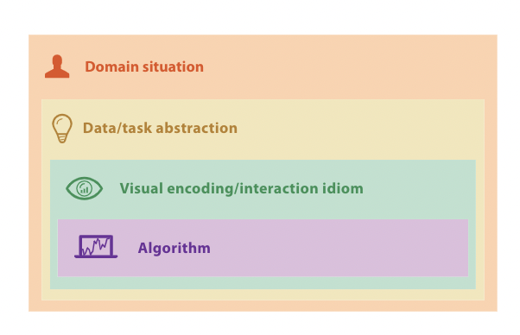
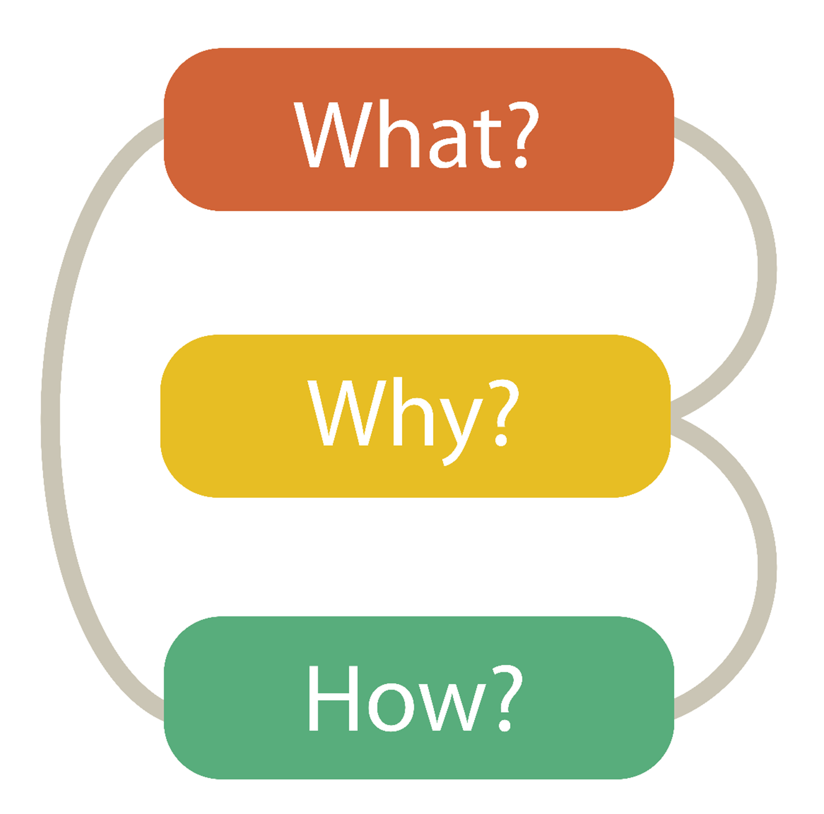

Visualization Building Blocks
Munzner’s Nested Model
Data Abstraction
Task Abstraction
Visual Encoding
Notes:
Last class we talked about the essential building blocks to a visualization tool, which were data, task, and visual encoding.
In other words, what why and how.
We also looked at how these pieces fit into the larger visualization design pipeline.

Slide 6
Visualization Building Blocks
Data Abstraction
Task Abstraction
Visual Encoding
Notes:
After that, we looked specifically at data abstraction, which consisted largely of understanding data types and dataset types.
Today, we’ll talk about Task Abstraction, or in other works distilling “why” we’re building a visualization tool down to specific tasks that a particular visualization can support.

Slide 7
Task Abstraction
From Munzner’s book

Slide 8
Task Abstraction
What?
The process of taking specific domain tasks and thinking about them as abstract (modular!) pieces
Notes:
Task abstraction is defined as the process of ….
For example, <next>

Slide 9

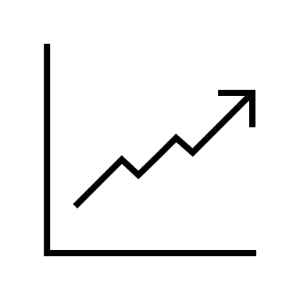
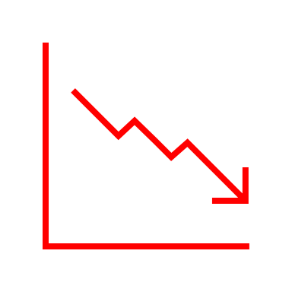
Task Abstraction
What?
The process of taking specific domain tasks and thinking about them as abstract (modular!) pieces
I need to perform cellular analysis.
I need to compare measure A to B over time.
Notes:
If you were working with a biologist, it would be the process of going from the biologist telling you they need a visualization to help them perform cellular analysis to you as the visualization designer determining that what the biologist needs is a visualization that allows them to compare measure A to measure B over time.
<next>

Slide 10
Task Abstraction
Why?
To translate domain specific terms into well known and transferable visualization tasks.
Notes:
Now, why is this important?
Because we need to be able to translate the domain specific terms our end users use into visualization specific tasks. This is important because different visualizations support different tasks.
In other words, understanding what fine-grained or low-level tasks a visualization tool needs to support, informs what type of visual encodings are appropriate later in the design pipeline.
Let’s look at a few examples.

Slide 11

Task Abstraction
Why?
To translate domain specific terms into well known and transferable visualization tasks.
Ex.
I need to show my boss which product we sold the most of last year.
Notes:
Consider this scenario, a business person is your end user and the domain task they need a visualization to support is <read>
Well, there are various visual encodings we could use to do this.

Slide 12
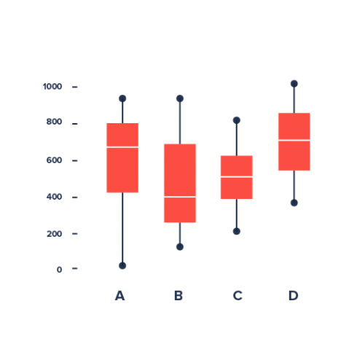
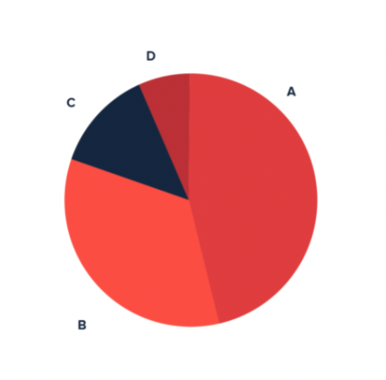
Task Abstraction
Why?
To translate domain specific terms into well known and transferable visualization tasks.
Ex.
I need to show my boss which product we sold the most of last year.
https://datavizproject.com/
Notes:
What do each of these visualizations show? What task would you use each for?
We can show how which product was sold the most of with a box plot that shows the distributions of daily product sales over the last year.
Or we could use a pie chart which shows how much of total sales each product was responsible for in the last year.
The appropriate visualization to use depends on the low-level task we need to support.

Slide 13
Task Abstraction
Why?
To translate domain specific terms into well known and transferable visualization tasks.
Compare distributions
Compare part-to-whole
Ex.
I need to show my boss which product we sold the most of last year.
https://datavizproject.com/
Notes:
In other words, is it important to compare sales distributions or to compare part of sales to the whole of sales?

Slide 14
Task Abstraction
Why?
To translate domain specific terms into well known and transferable visualization tasks.
Compare distributions
Compare part-to-whole
Ex.
I need to show my boss which product we sold the most of last year.
Need to compare part-to-whole.
https://datavizproject.com/
Notes:
Once you narrow this down, it is clear that the pie chart is the better choice in this case.

Slide 15

Task Abstraction
Why?
To translate domain specific terms into well known and transferable visualization tasks.
Ex.
I want to see which months are best for outdoor dining.
Notes:
Let’s look at another example. Suppose your end user is a restaurant owner with the following domain task.
Similar to before, the low-level task or tasks that correspond to this domain task are not immediately apparent.
As a result, there are multiple visual encodings that could help with this task.

Slide 16
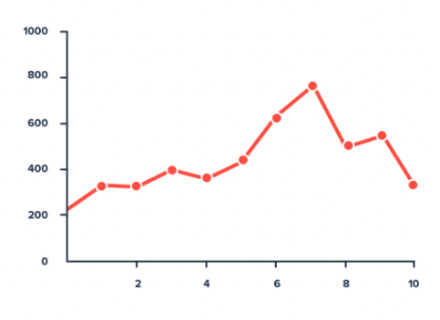
Task Abstraction
Why?
To translate domain specific terms into well known and transferable visualization tasks.
Ex.
I want to see which months are best for outdoor dining.
https://datavizproject.com/
Notes:
What do each of these visualizations show?
For example, a line chart could show average temperature for each month over the year, which could help us decide which months are most suitable for outdoor dining.
And a box plot could show us distributions of temperature for each month over the year.
Again, the appropriate visualization to use depends on the low-level task we need to support.

Slide 17
Task Abstraction
Why?
To translate domain specific terms into well known and transferable visualization tasks.
Average trend
Compare distributions
Ex.
I want to see which months are best for outdoor dining.
https://datavizproject.com/
Notes:
In other words, does this domain task boil down to looking at an average trend in temperature, or comparing distributions of temperatures?

Slide 18
Task Abstraction
Why?
To translate domain specific terms into well known and transferable visualization tasks.
Average trend
Compare distributions
Ex.
I want to see which months are best for outdoor dining.
Need to compare distribution over months.
https://datavizproject.com/
Notes:
Once we know which of those low-level tasks supports the larger domain task, we know which visual encoding is appropriate to use in this scenario.

Slide 19
Task Abstraction
Why?
To translate domain specific terms into well known and transferable visualization tasks.
Notes:
Hopefully those examples convinced you why task abstraction is important. But now you. Might be left with the question, what are these “well known and transferable visualization tasks” that we need to translate (or abstract) domain tasks into?

Slide 20
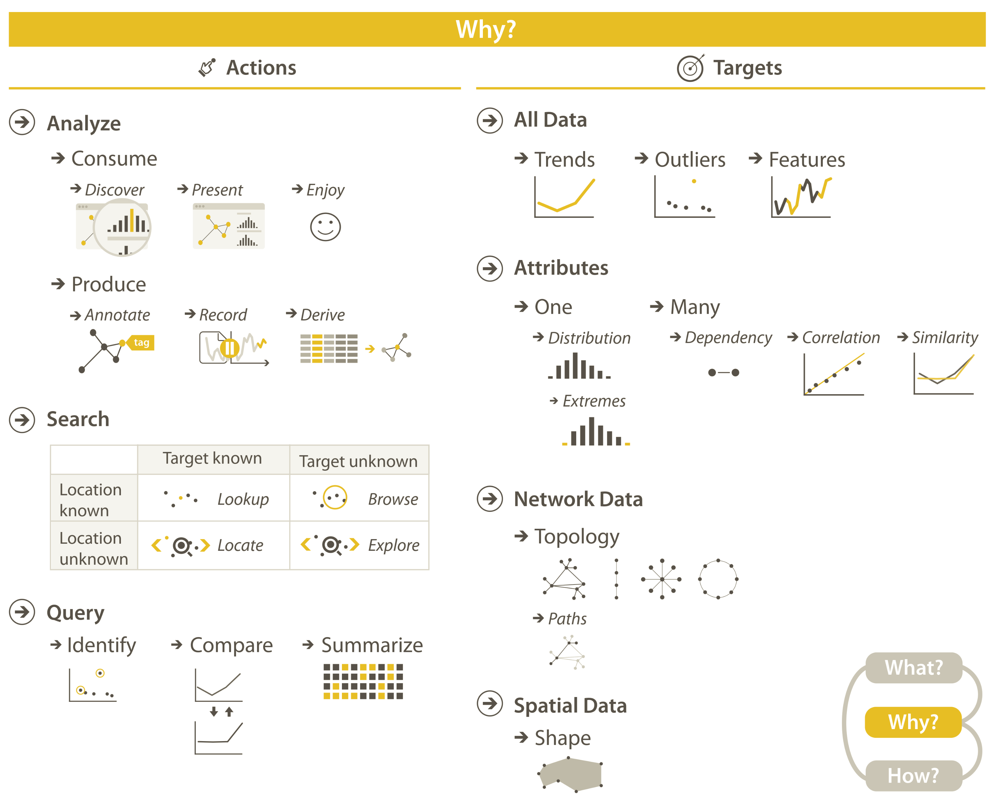
Task Abstraction
Notes:
A list of well known and transferable visualization tasks is often referred to as a task taxonomy.
There are multiple task taxonomies that you can use to guide visualization design, but to start we’re going to focus on Tamara Munzner’s.
In her approach to task abstraction Tamara advocates for breaking down tasks into actions and targets, which together define the “why” behind a visualization.

Slide 21
Task Abstraction
Actions
3 Levels:
- High
- Medium
- Low
Notes:
Let’s start by talking about actions, or what users will use your visualization to accomplish.
Munzner breaks actions into three levels of abstraction, high, medium, and low. <next>

Slide 22
Task Abstraction
Actions
3 Levels:
- High
- Medium
- Low
Notes:
High-level actions describe how a visualization is being used to analyze.
Medium-level actions describe what type of search is required for those high-level actions.
And Low-level actions describe the particular query or question the visualization will need to support.
Let’s look at each of these levels in more detail. <next>

Slide 23
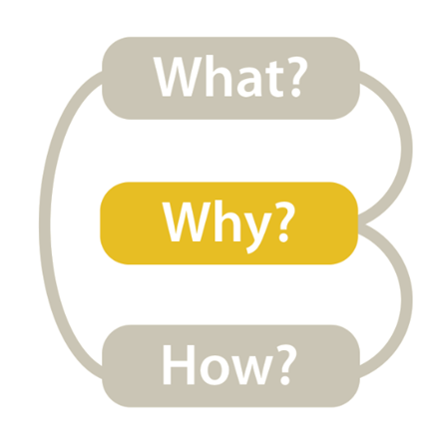
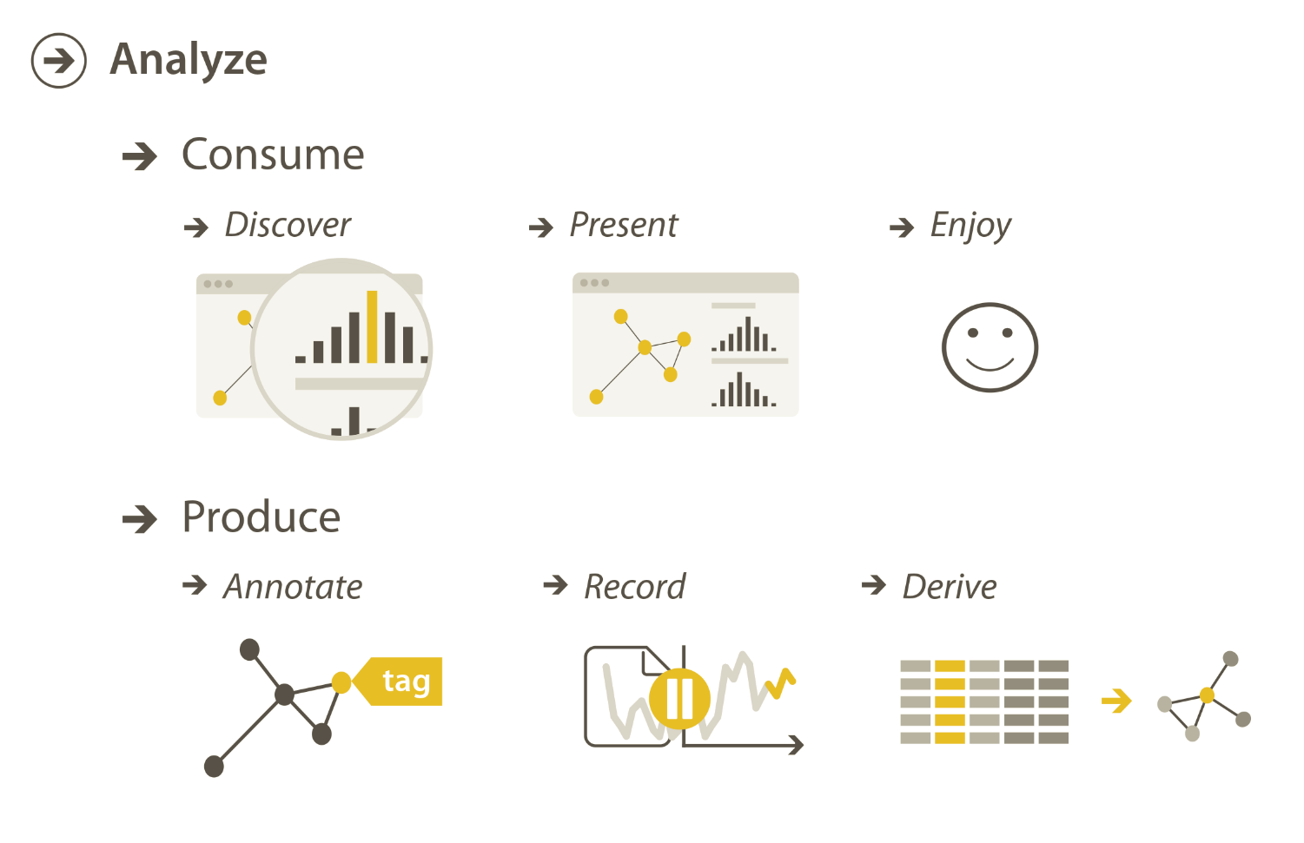
Task Abstraction
High-level → How is the vis being used to analyze?
Notes:
Broadly, Tamara breaks high-level actions into two categories consuming existing information or producing new information.
Within consume, there are three cases:
The goal of having the user discover new information that was not already completely understood
The goal of presenting information that the user already understands to a third party
The goal enjoyment, i.e. using the vis to pursue casual interests in a topic
Within Produce there are three more cases:
The goal of annotating a given visualization
The goal of recording a persistent artifact of the visualization
The goal of deriving new data elements based on existing ones.
Let’s look at all of these in detail.

Slide 24
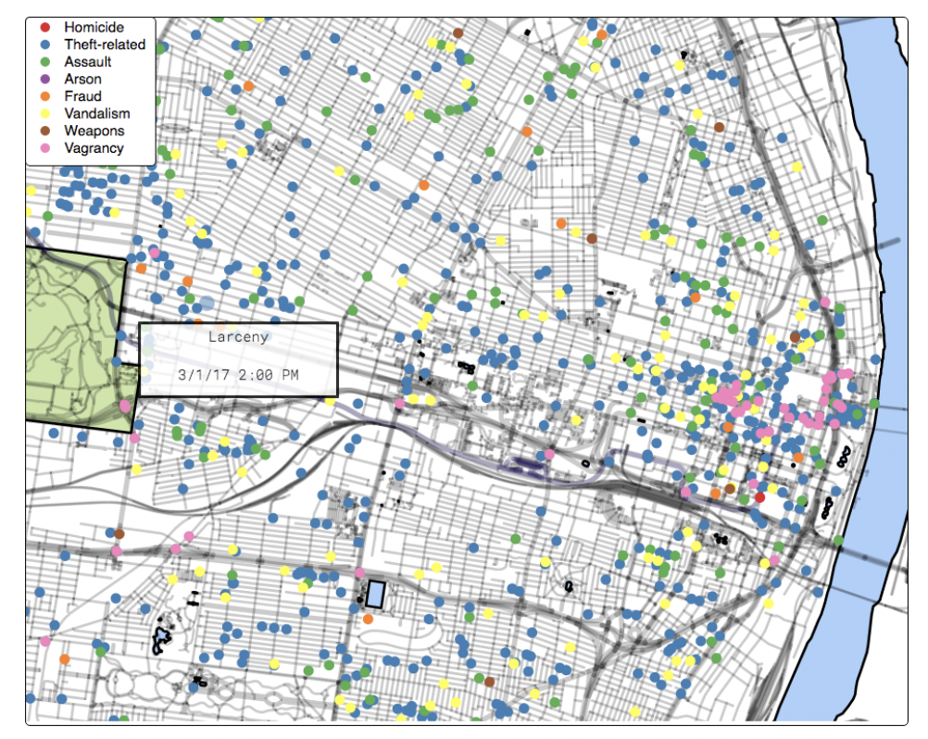
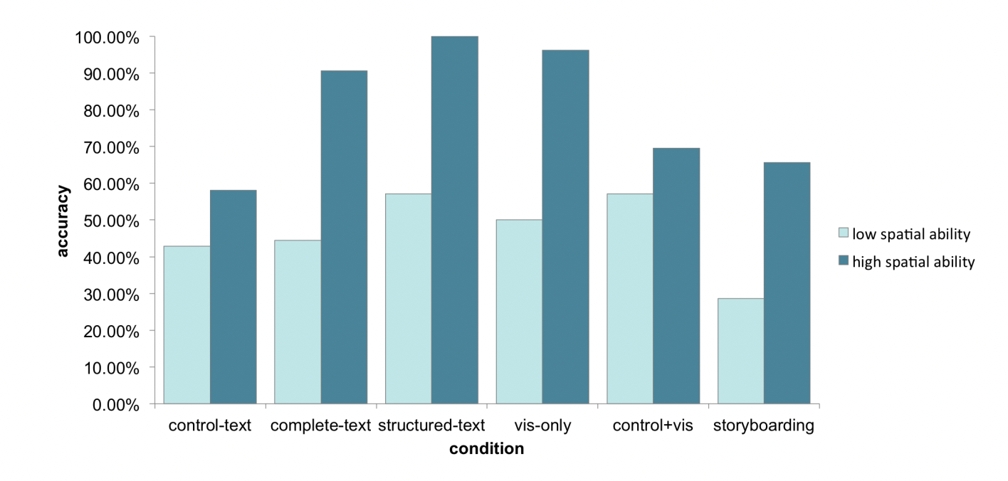
Task Abstraction
High-level → Consume → Discover
Follow The Clicks: Learning and Anticipating Mouse Interactions During Exploratory Data Analysis. Ottley et al. 2019
Improving Bayesian Reasoning: The Effects of Phrasing, Visualization, and Spatial Ability. Ottley et al. 2016
Notes:
Within consume, our first case is discover.
Discover refers to using a vis to find new knowledge that was not previously known.
This can range from using a vis to form a hypothesis, to using a vis to verify a hypothesis the user already had.
For example, the visualization on the left shows reported crimes in the city of St. Louis for March 2017. One reason someone might use this visualization is to come up with a hypothesis about types of crimes in different neighborhoods.
In contrast, someone would use the visualization on the right with the goal of testing the hypothesis that people with low spatial ability perform a given task worse on average than people with high spatial ability.

Slide 25
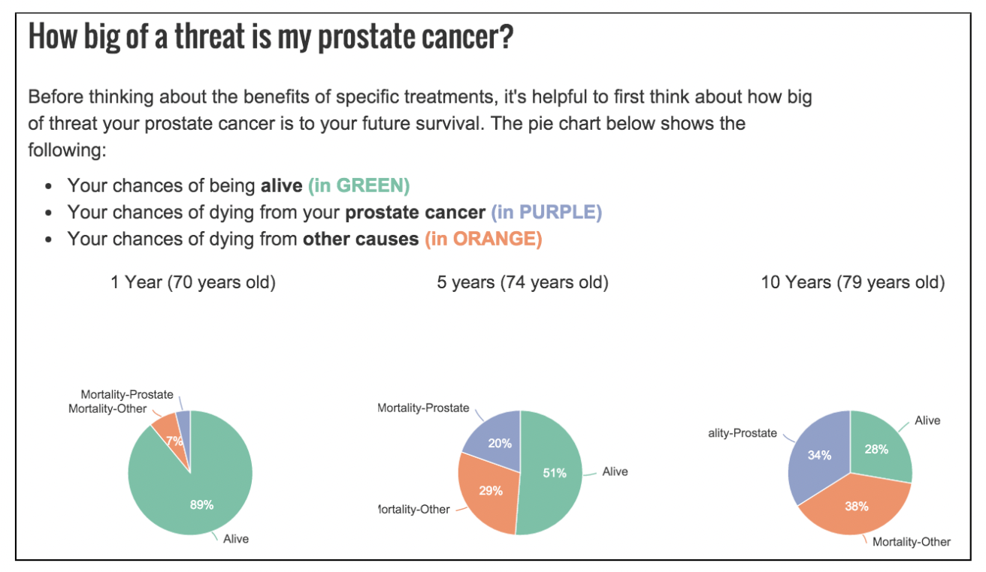
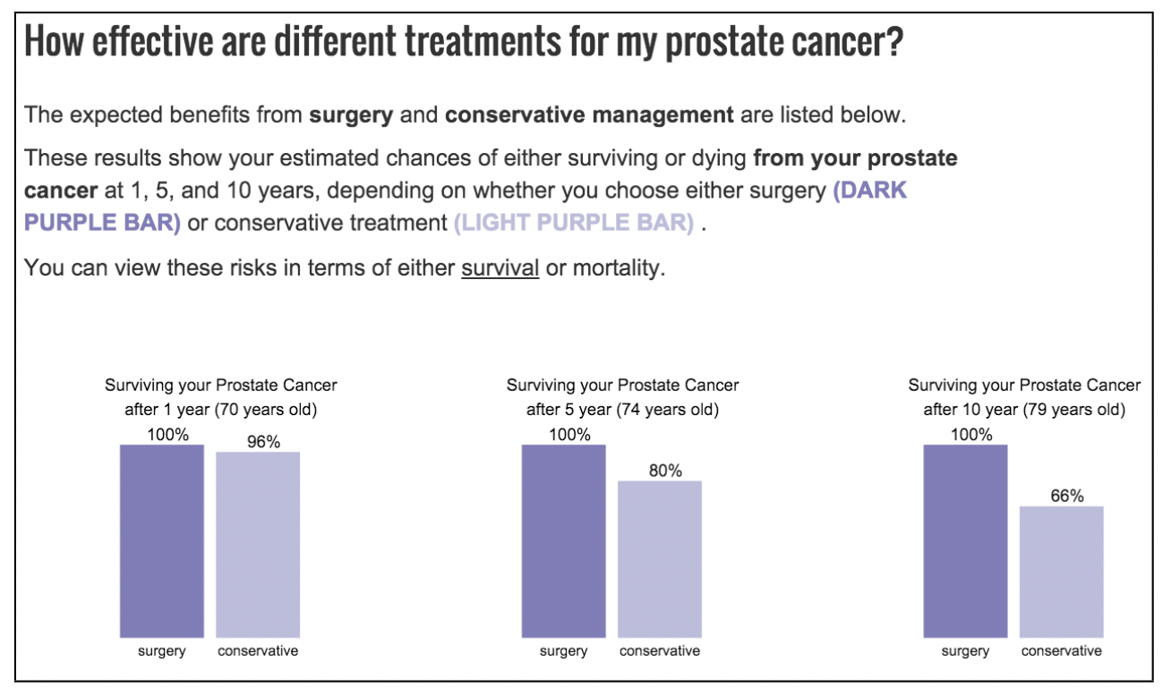
Task Abstraction
High-level → Consume → Present
PROACT: Iterative Design of a Patient-Centered Visualization for Effective Prostate Cancer Health Risk Communication. Hakone et al. 2016.
Notes:
A different case under Consume is using a visualization to present. This refers to using a visualization to communicate known information to an unfamiliar third party.
For example, these visualizations show statistics associated with different medical tests and treatments. They would be used by doctors who are trying to introduce their patients to unfamiliar information.

Slide 26
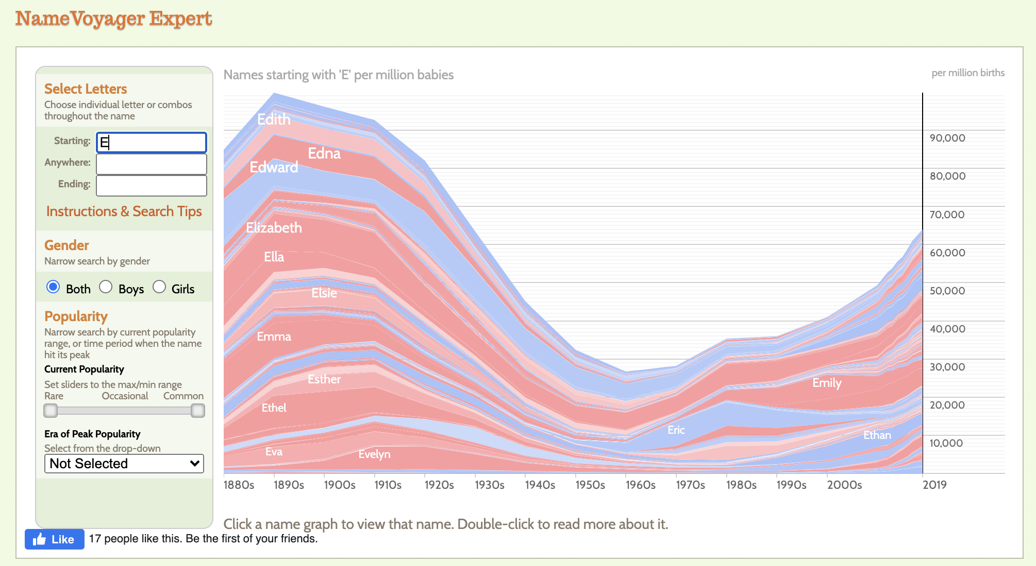
Task Abstraction
High-level → Consume → Enjoy
https://www.babynamewizard.com/namevoyager-expert#prefix=e&sw=both&exact=false
Notes:
The last case under consume is to enjoy. Enjoy refers to casual encounters with visualization that are driven by curiosity, but not the need to form or validate a hypothesis.
For example, this visualization shows baby name popularity over the years. Expecting parents may use it (or stumble upon it) out of curiosity, but not due to a pressing need.

Slide 27
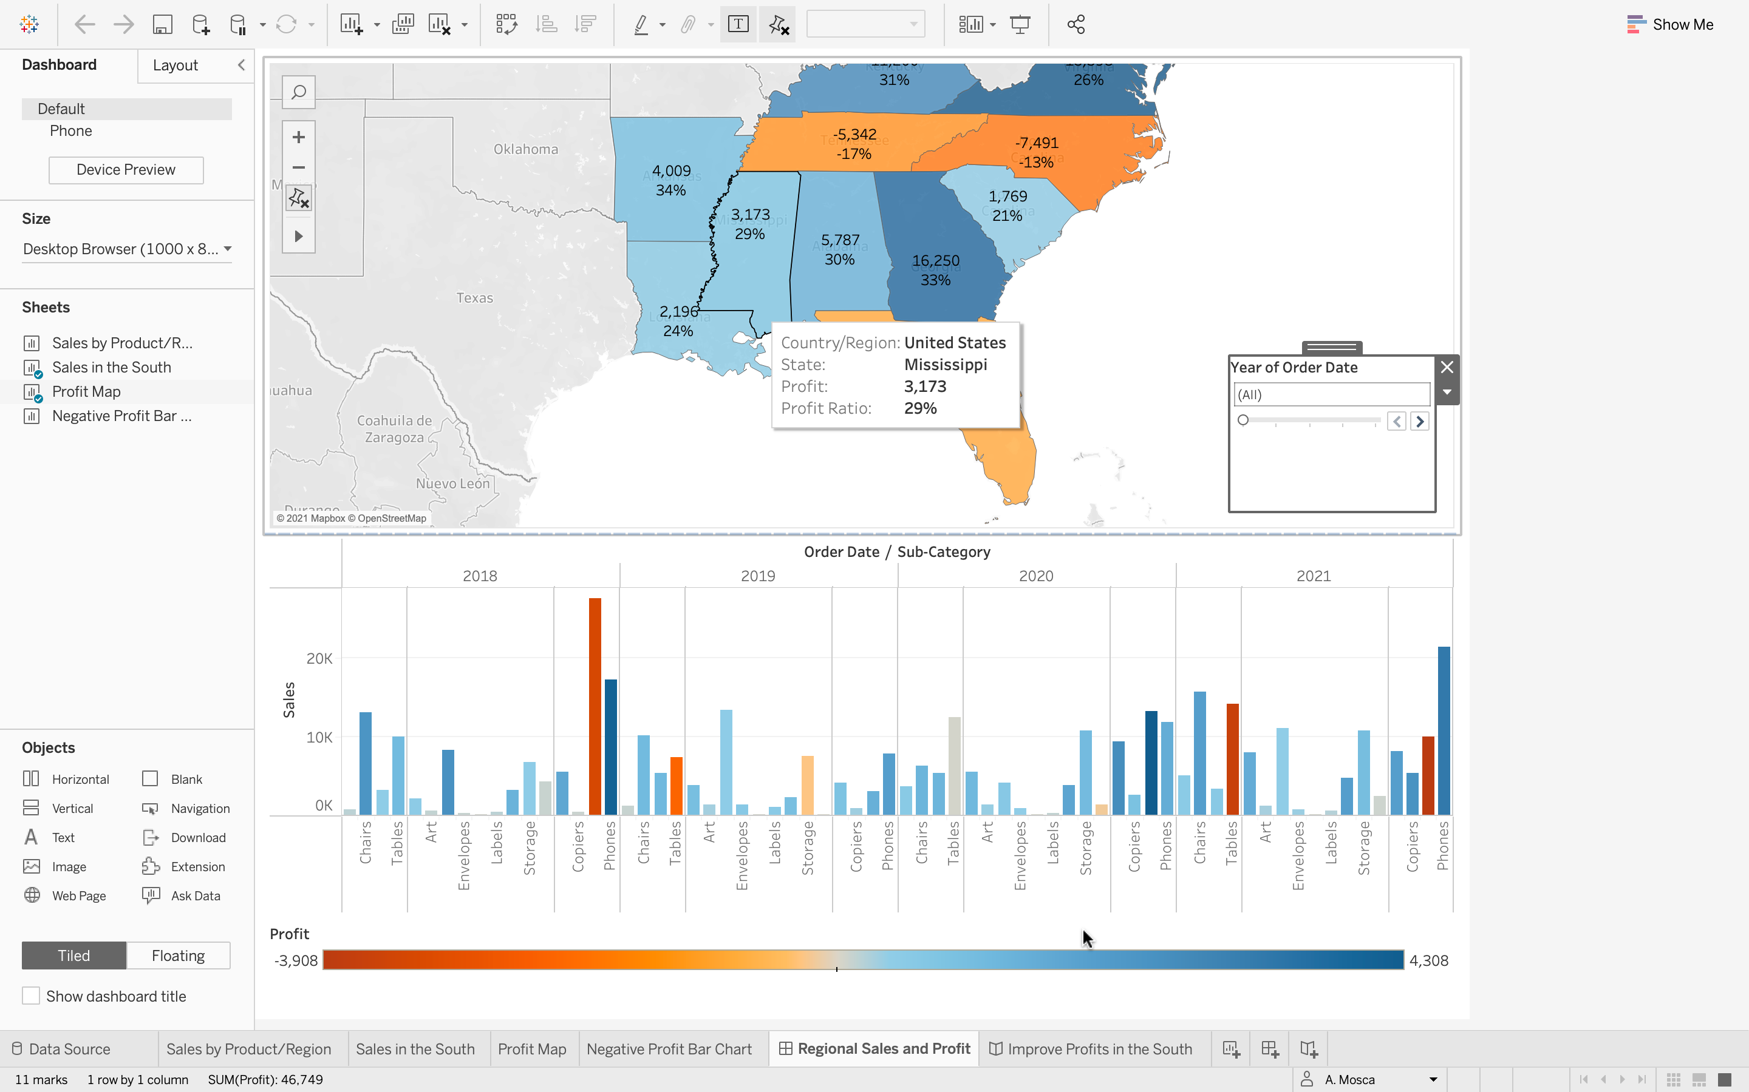

Task Abstraction
High-level → Produce → Annotate
Notes:
Now let’s switch into the other major class of high-level actions, which is produce. Typically produce visualizations are tools build to help people perform a visual analysis of data. To do this, they need to create visualizations.
One task required to create visualizations is annotation
Annotate refers to taking a visualization, and adding graphical or textual annotation to it.
Using Tableau is an example of using a visualization tool for the purpose of annotation. It allows you to take an existing visualization add additional information as needed such as tooltips or notes to a future user.

Slide 28
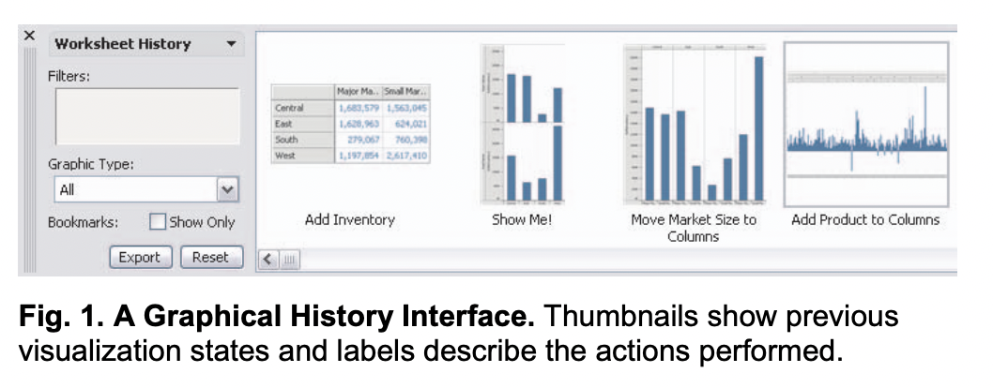
Task Abstraction
High-level → Produce → Record
Graphical Histories for Visualization: Supporting Analysis, Communication, and Evaluation. Heer et al. 2008
Notes:
The second case within Produce is record. Record refers to using a visualization and saving or capturing elements of the visualization as persistent artifacts.
We often call this visualization provenance, and it can be especially important if visualizations are being built to aid with a data analysis.

Slide 29
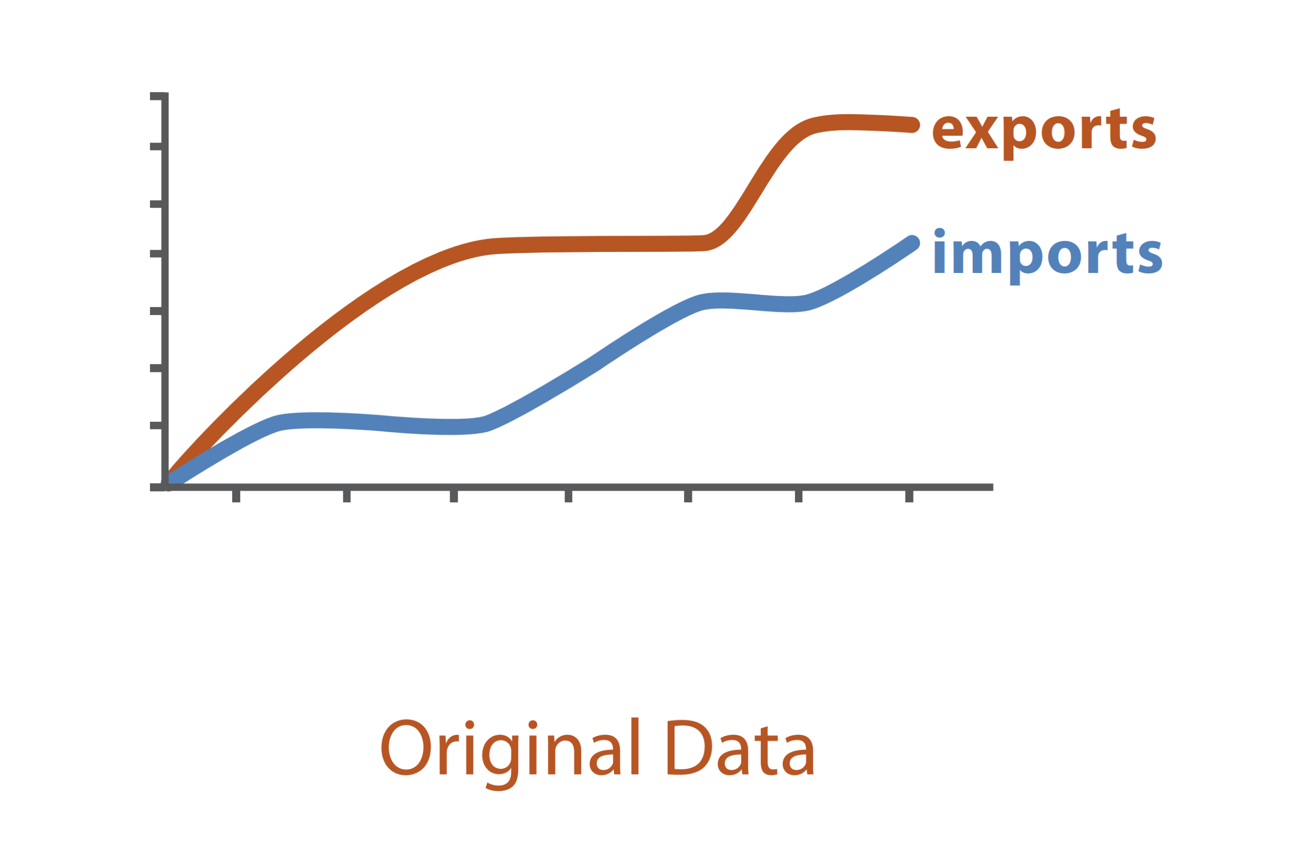
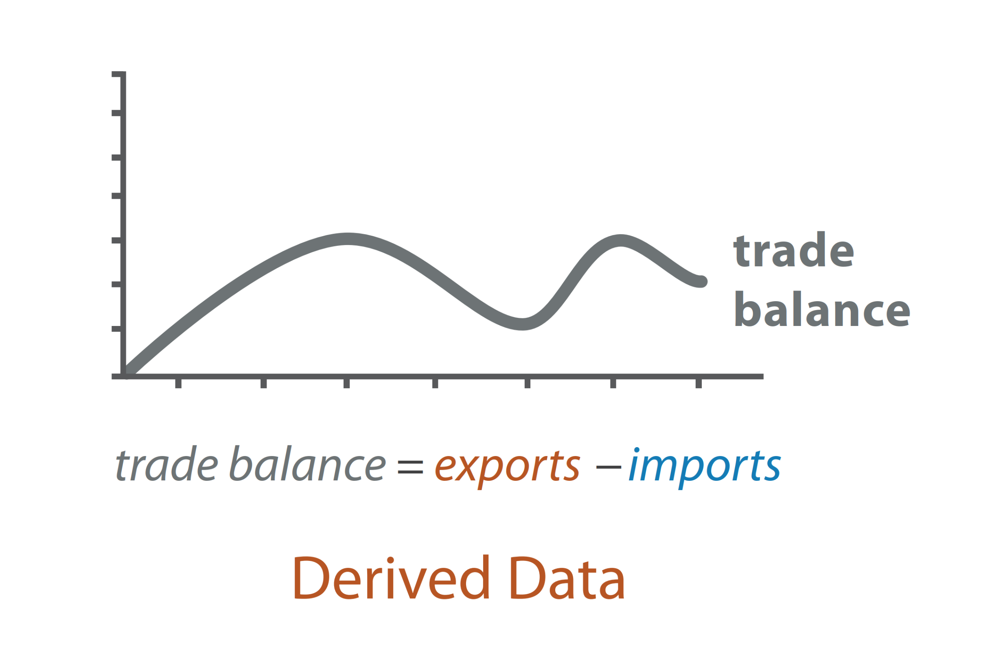
Task Abstraction
High-level → Produce → Derive
Exports | Imports
10000 | 9000
15000 | 9050
… | …
Exports | Imports | Trade Balance
10000 | 9000 | 1000
15000 | 9050 | 5950
… | … | …
Notes:
The last high-level action within produce is derive. Derive refers to the goal of producing new attributes based on existing ones.
For example here, the goal of using the visualization on the left which shows exports and imports is to derive trade balance, which is shown in the visualization on the right.

Slide 30
Task Abstraction
High-level → How is the vis being used to analyze?
Notes:
That sums up all of our high-level actions. Any questions before we move on to mid and low level?

Slide 31
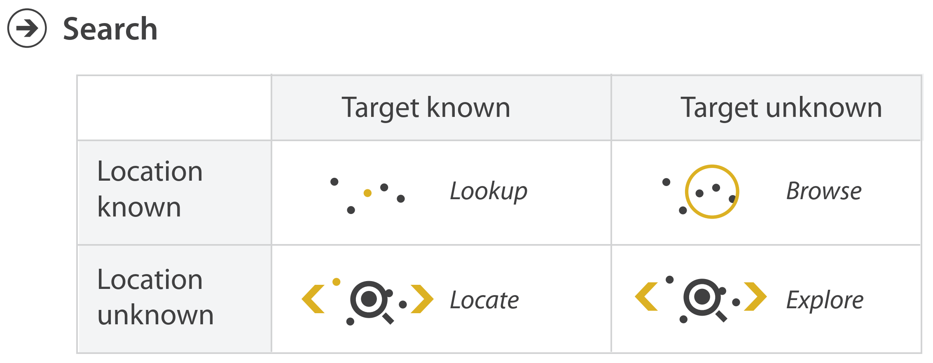
Task Abstraction
Mid-level → Search
Notes:
Our mid-level action is search. Each of the high-level actions we just talked about require the user to search for elements of interest within the visualization they’re using.
Notably, searches can look different depending on whether the target and location of the search are known by the user.
Let’s look at each instance of search.

Slide 32

Task Abstraction
Mid-level → Search → Lookup
What is the address of Ryder Hall?
Notes:
On case, is there the target of the search and the location of the search are both known by the user.
We call searches like this “Lookup” searches.
For example, say you know where Ryder Hall is but someone asks you for the address, which you don’t know off the top of your head. To get them the address, you might open Google maps, navigate to Ryder Hall, and click on it to get the address. That’s an example of a Lookup search, because you knew your target (Ryder Hall), and the location (where Ryder is on the map).

Slide 33
Task Abstraction
Mid-level → Search → Lookup
How much profit was there for Mississippi?
Notes:
Another example of this would be looking for additional information in a tooltip when you know the target and location of your search.

Slide 34
Task Abstraction
Mid-level → Search → Locate
Where is Ryder Hall?
Notes:
If the target of a search is known but the location is unknown, we have a type of search we call locate.
An example of this type of search would be if you knew you have a class in Ryder Hall, but don’t know where Ryder Hall is on campus. To find out where to go for class, you might open google maps, and search for Ryder Hall by typing it in the search bar. This is an example of a Locate search, because you know your target (Ryder Hall), but not the location.

Slide 35
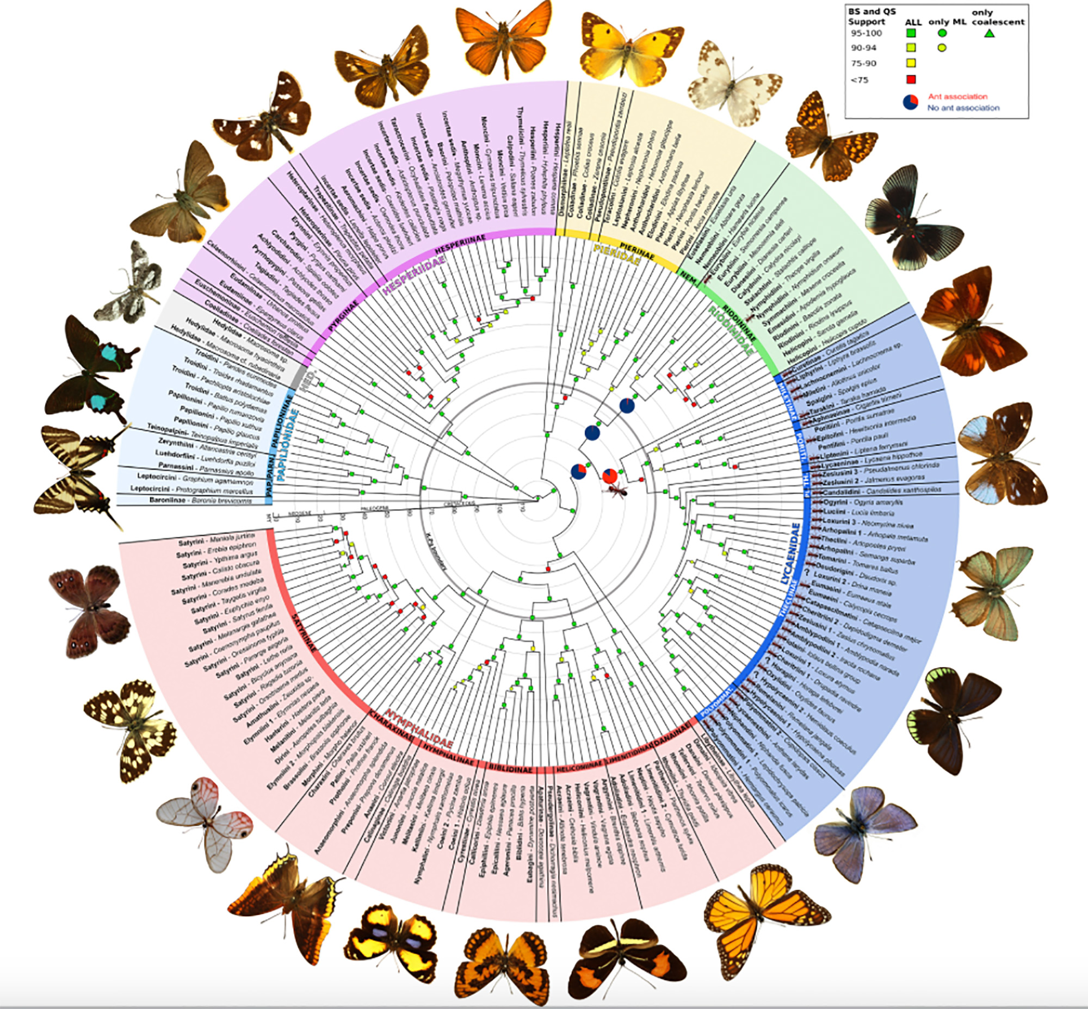
Task Abstraction
Mid-level → Search → Locate
Where is the Monarch butterfly?
https://www.floridamuseum.ufl.edu/science/at-last-butterflies-get-a-bigger-better-evolutionary-tree/
Notes:
Another example of this type of search would be using this visualization and trying to find the genius and species of monarch butterfly. In this case your target (monarch butterfly) is known, but it’s location is not known.

Slide 36
Task Abstraction
Mid-level → Search → Browse
What buildings are near Ryder Hall?
Notes:
The third type of search is when the target is unknown, but the location is known. We call this type of search Browse.
For example, say you have a class in Ryder Hall and you want to find a good place to study after class. To find a place to study, you might open Google maps, navigate to Ryder Hall, and browse the different buildings nearby searching for a good study location. This is an example of a Browse search, because your target is unknown, but your location (near Ryder Hall) is known.

Slide 37
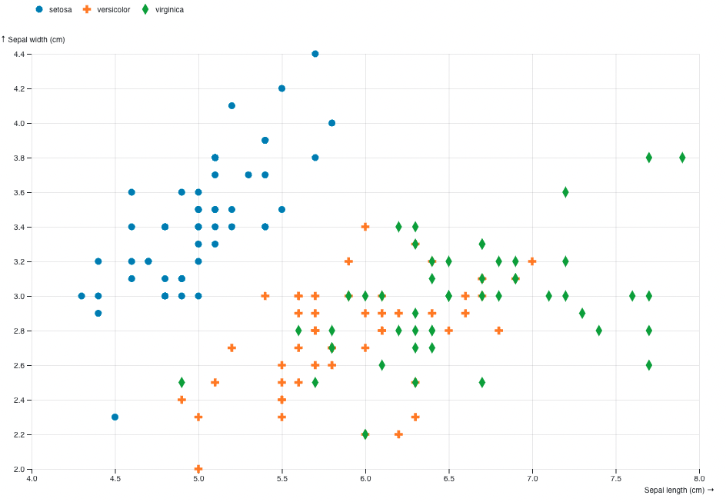
Task Abstraction
Mid-level → Search → Browse
Which Irises have sepal length greater than 7.5?
https://observablehq.com/@d3/scatterplot-with-shapes
Notes:
Another example of this type of search would be using a scatterplot and knowing a specific attribute value you are interested in, but not knowing what items meet that requirement.

Slide 38
Task Abstraction
Mid-level → Search → Explore
Where can I study?
Notes:
The last type of search is one where the target and location are unknown. We call this type of search explore.
For example, let’s pretend that you are generally looking for new places to study. To find a place, you might open google maps and pan around to different areas looking for a good place to study. This is an example of an explore search, because you don’t have a known target or location.

Slide 39
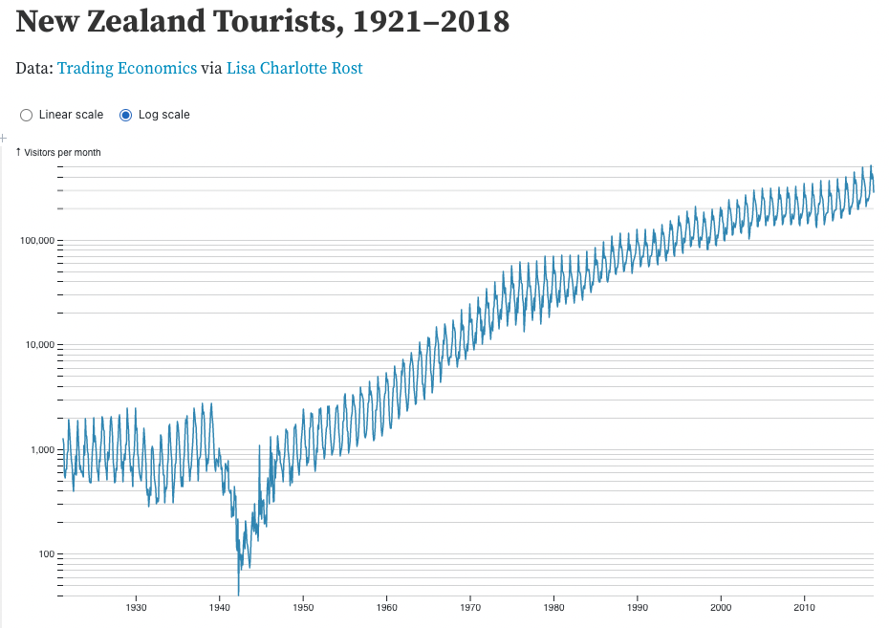
Task Abstraction
Mid-level → Search → Explore
Is there a seasonal trend is tourism?
Are there any unusual years?
https://observablehq.com/@mbostock/new-zealand-tourists-1921-2018
Notes:
Another example of an explore search is looking for outliers or overall trends in a line chart.

Slide 40
Task Abstraction
Mid-level → Search
Notes:
That sums up mid-level actions, which are searches. Any questions before we move on to low-level actions?

Slide 41
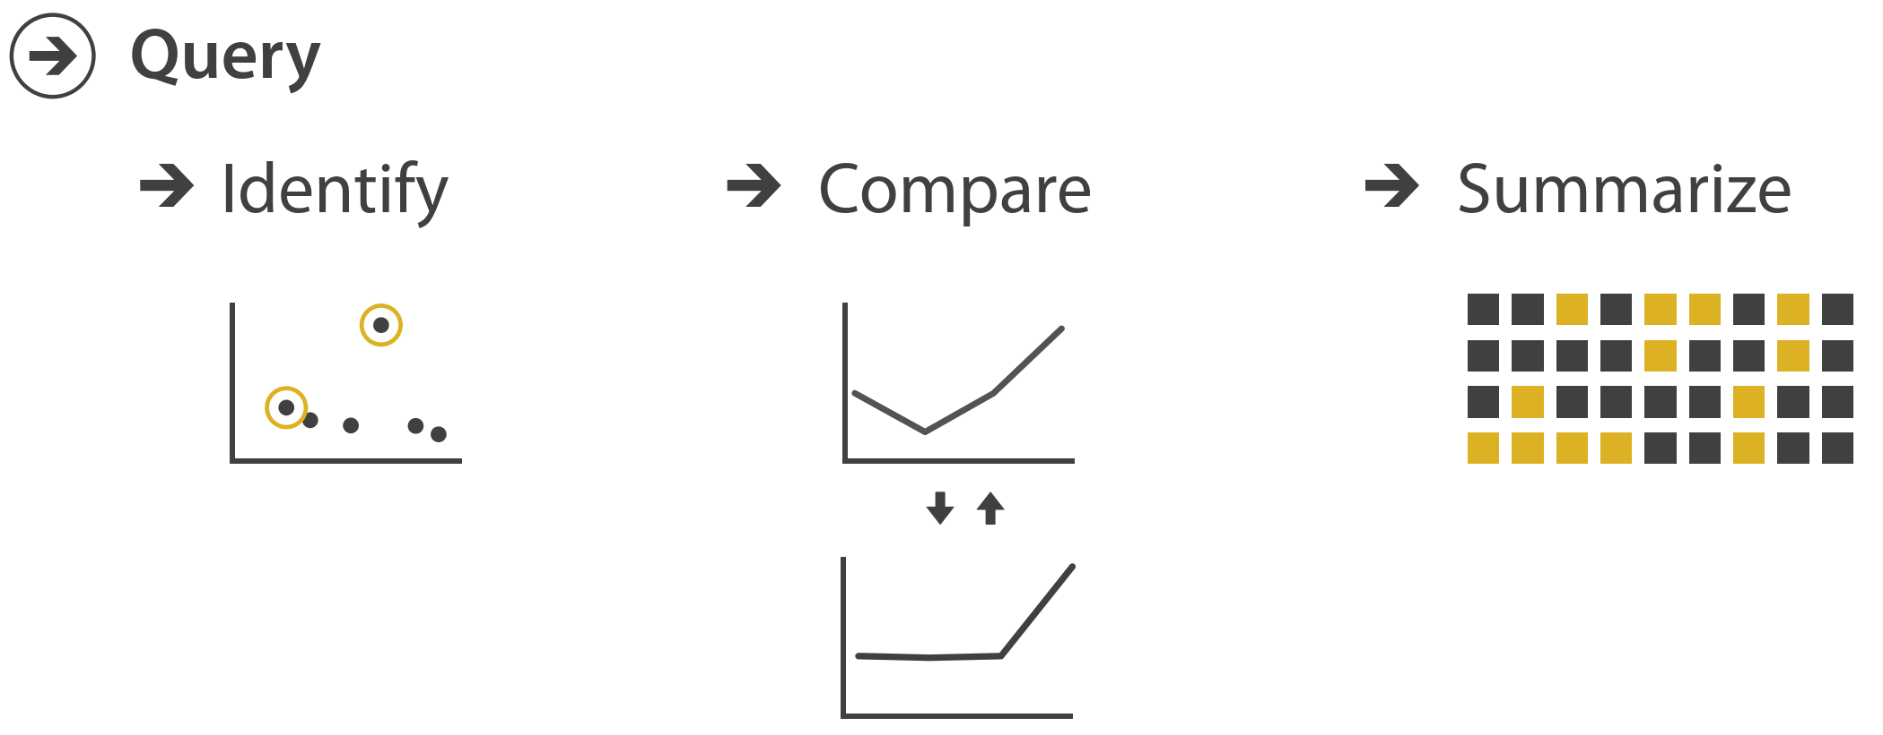
Task Abstraction
Low-level → Query
Notes:
After a user finds their target(s) in the search stage, they will need to query their target(s) in one of three scopes. We call those different queries low-level actions, and we differentiate them based on the number of targets involved. <next>

Slide 42
Task Abstraction
Low-level → Query→ Identify
single target
https://www.floridamuseum.ufl.edu/science/at-last-butterflies-get-a-bigger-better-evolutionary-tree/
Notes:
Our first query type is identify, this corresponds to a single target. For example, finding Ryder Hall, or the monarch butterfly.

Slide 43
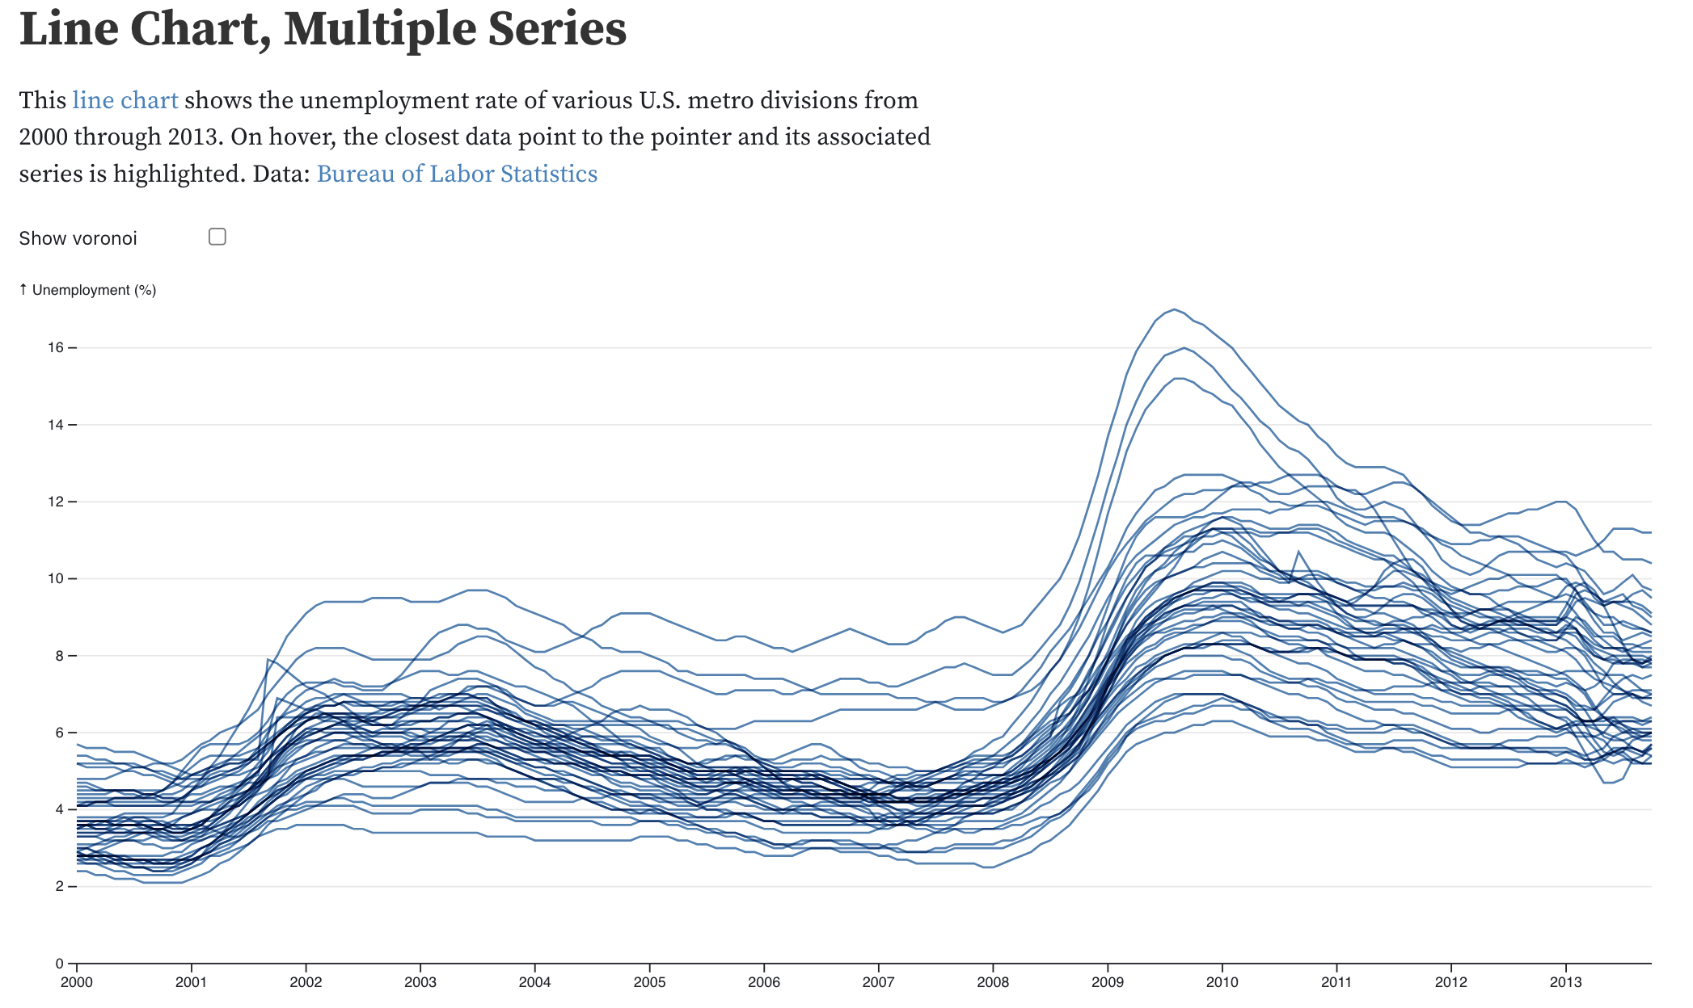
Task Abstraction
Low-level → Query→ Compare
multiple targets
PROACT: Iterative Design of a Patient-Centered Visualization for Effective Prostate Cancer Health Risk Communication. Hakone et al. 2016.
https://observablehq.com/@d3/multi-line-chart
Notes:
The next query type is compare, which corresponds to a user having multiple targets that they want to compare.
For example, comparing different survival outcomes given different treatments, or comparing sepal width and length of two irises.

Slide 44
Task Abstraction
Low-level → Query→ Summarize
all targets
Follow The Clicks: Learning and Anticipating Mouse Interactions During Exploratory Data Analysis. Ottley et al. 2019
Notes:
The final query type is summarize, which corresponds to the users wanting an overview (or summary) of all their analysis targets.
For example, looking at an overview of the types of crimes in different parts of St. Louis, or looking at profit across several states.

Slide 45
Task Abstraction
Low-level → Query
single target
multiple targets
all targets
Notes:
That sums up low-level tasks, or query types. Any questions?

Slide 46
Task Abstraction
Targets
Some aspect of the data of interest to the user
Notes:
Now that we’ve looked at actions in depth, let’s take a look at targets.

Slide 47
Task Abstraction
Targets→ some aspect of data of interest to the user
Notes:
Similar to actions, we think of targets as high or low level. <next>

Slide 48
Task Abstraction
Targets→ some aspect of data of interest to the user
Notes:
At a high-level, no matter what type of data we’re talking about, users are attempting to identify one of three things
A trend, or pattern in the data
Outliers, or unusual data
Features, which vary by task but refer to any other particular structures of interest

Slide 49
Task Abstraction
Targets→ some aspect of data of interest to the user
Notes:
At a low-level, we think of attributes, or specific properties that are visually encoded.
When only one attribute is of interest, the user can either focus on the distribution for that attribute, or the extremes (max / min)
When more than one attribute is of interest, the user can look for a dependency, correlation, or similarity.
Note, that each of these targets are abstract, meaning they are general ideas around which we can build visualizations. Each of these targets could also be spoken about in domain terms (for example, the cellular analysis example from before). Our goal with Task Abstraction is to move from those domain terms to these abstract terms.

Slide 50
Task Abstraction
Targets→ some aspect of data of interest to the user
Notes:
Last but not least, there are some targets that only pertain to specific types of data.
For example, When a user is concerned with network data their target could be topology (structure), or specific paths in a network.
Or when a user is concerned with spatial data their target could be geometric shapes (for example, comparing two different shapes).

Slide 51
Task Abstraction
Targets→ some aspect of data of interest to the user
Notes:
That sums up targets. Any questions?
Take a few minutes to look brainstorm examples of these different types of targets and the domain task they might come from.

Slide 52
Example Task Abstraction
Notes:
Now that we’ve covered the various definitions and principles, let’s walk through a task abstraction.

Slide 53

Task Abstraction
Domain Task: I need to perform cellular analysis!
Visualization Task: compare measure A to B over time.
Notes:
Let’s return to our example from before where we had the biologist, and the visualization designer.
Given this domain task, and the visualization task we’ve identified, can you abstract what high, medium, and low level actions we need our visualization to support?

Slide 54

Task Abstraction
Visualization Task: compare measure A to B over time.
High-level →
? →
?
Medium-level →
Search →
?
Low-level → Query →
?
Notes:
Let’s return to our example from before where we had the biologist, and the visualization designer.
Given this domain task, and the visualization task we’ve identified, can you abstract what high, medium, and low level actions we need our visualization to support?

Slide 55
Task Abstraction
Visualization Task: compare measure A to B over time.
High-level →
Produce →
Discover
Medium-level →
Search →
Lookup (or Locate)
Low-level → Query → Compare

Slide 56
Task Abstraction
High-level →
Produce →
Discover
Visualization Task: compare measure A to B over time.
Medium-level →
Search →
Lookup
Low-level → Query → Compare
Target(s)
Notes:
Now what about targets? Can you identify the target or targets of this analysis?

Slide 57
Task Abstraction
High-level →
Produce →
Discover
Visualization Task: compare measure A to B over time.
Medium-level →
Search →
Lookup
Low-level → Query → Compare
Target(s)
→ Attributes → Similarity
Notes:
Now what about targets? Can you identify the target or targets of this analysis?

Slide 58
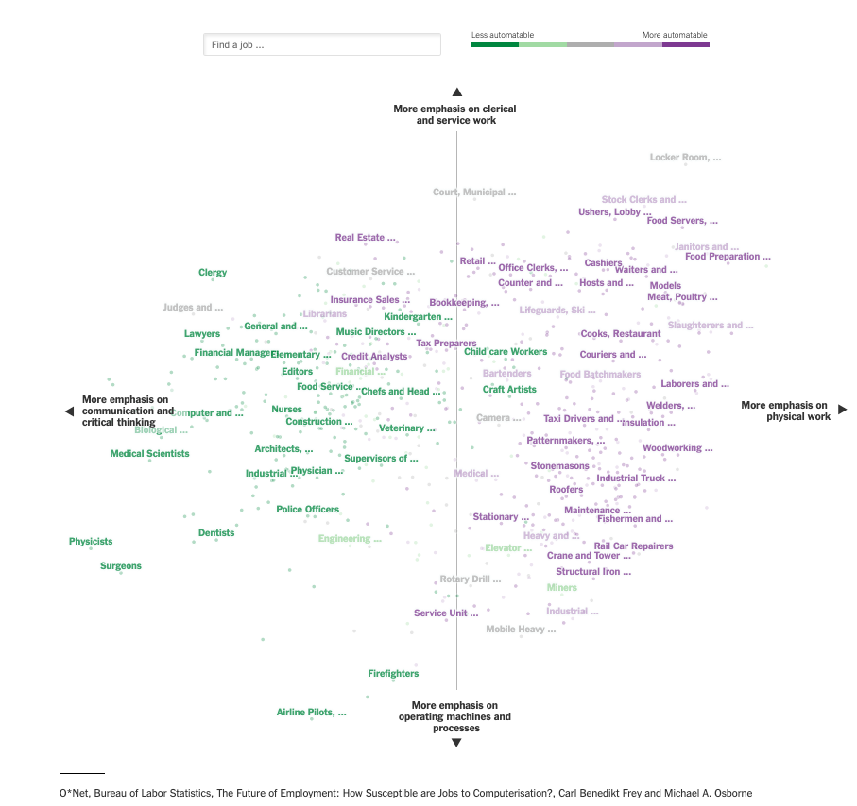
Task Abstraction
High-level →
? →
?
Medium-level →
Search →
?
Low-level → Query →
?
https://www.nytimes.com/2019/03/14/learning/whats-going-on-in-this-graph-march-20-2019.html
Notes:
Let’s return to our example from before where we had the biologist, and the visualization designer.
Given this domain task, and the visualization task we’ve identified, can you abstract what high, medium, and low level actions we need our visualization to support?

Slide 59
Task Abstraction
High-level →
Consume →
Present
Medium-level →
Search →
Explore (Lookup)
Low-level → Query →
Summarize (Compare)
https://www.nytimes.com/2019/03/14/learning/whats-going-on-in-this-graph-march-20-2019.html
Notes:
Let’s return to our example from before where we had the biologist, and the visualization designer.
Given this domain task, and the visualization task we’ve identified, can you abstract what high, medium, and low level actions we need our visualization to support?

Slide 60
Task Abstraction
High-level →
Consume →
Present
Medium-level →
Search →
Explore (Lookup)
Low-level → Query →
Summarize (Compare)
Target(s)
https://www.nytimes.com/2019/03/14/learning/whats-going-on-in-this-graph-march-20-2019.html
Notes:
Let’s return to our example from before where we had the biologist, and the visualization designer.
Given this domain task, and the visualization task we’ve identified, can you abstract what high, medium, and low level actions we need our visualization to support?

Slide 61
Task Abstraction
High-level →
Consume →
Present
Medium-level →
Search →
Explore (Lookup)
Low-level → Query →
Summarize (Compare)
Target(s) → All Data → Trends (Attribute → Distribution)
https://www.nytimes.com/2019/03/14/learning/whats-going-on-in-this-graph-march-20-2019.html
Notes:
Let’s return to our example from before where we had the biologist, and the visualization designer.
Given this domain task, and the visualization task we’ve identified, can you abstract what high, medium, and low level actions we need our visualization to support?

Slide 62
Let’s take a break! Stretch, go for a walk, be social ☺ Be back here in 10 mins.

Slide 63
Interviewing Domain Experts

Slide 64


Human-Centered Design
What do you need a visualization for?
I want to see how my students are doing from year to year.
How do you measure student success?
Validation
Final grades in the class.
To compare average grade of each class since I started teaching.
What kinds of comparisons or statistics do you need?
I’ll start with a line chart showing average grade per year.
I’ll code it in Tableau.

Slide 65
Interview Tips
Your interviewee is the expert in what they do. Let them explain it to you
→ What does your day to day consist of?
→ How would you explain this task to a new employee?
→ What tools do you need to be successful?

Slide 66
Interview Tips
Ask specific questions
→ Can you explain your workflow to me in five steps?
vs.
Tell me about your workflow.
→ Please describe three pain points in your current process.
vs.
Are there any pain points in your current process?
→ Please describe three positive aspects of your current process.
vs.
What parts of your process do you like or want unchanged?

Slide 67
Interview Tips
Be as interactive as possible. Ask follow-ups.
→ Can you explain more about <X> part of your current workflow?
→ When you explained what works well for you now, you mentioned <Y>. Could you tell me about <Y> in more detail?
→ You mentioned <Z> as a current pain point. In an ideal world, how would <Z> be alleviated?

Slide 68
In-class exercise: Mock Interview (ic-03)

Slide 69
Summary
Today we:
Reviewed Task Abstraction
Practiced interviewing an end user to understand tasks
hw-02 is DUE before next class.
ic-03 is DUE today.

